Slide 1
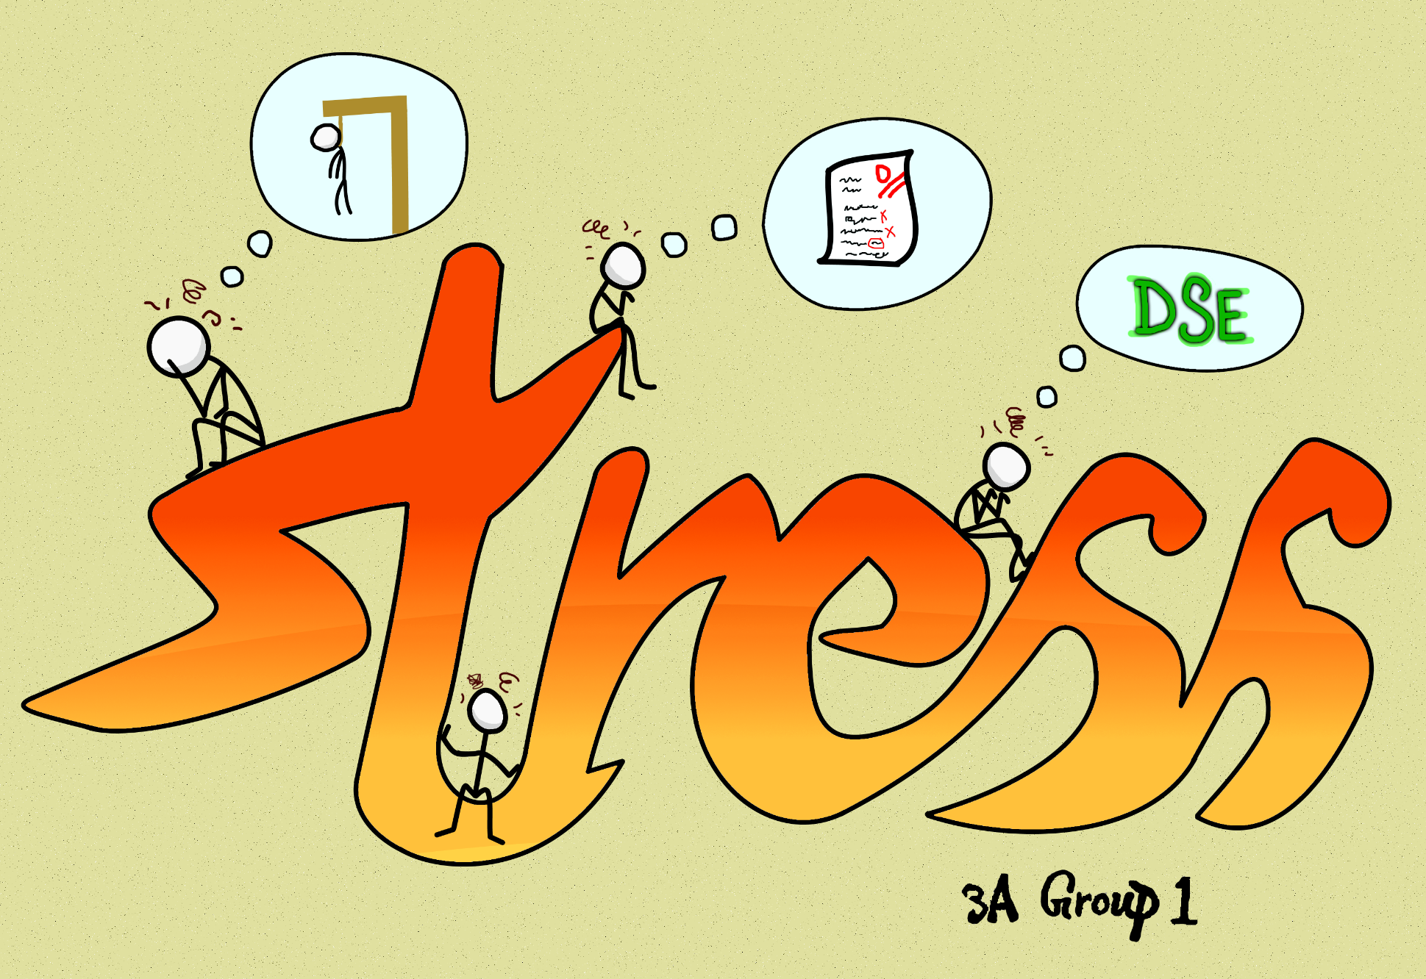

Group Leader:
Chen Ze Yu Bill
Group Members:
Chan Cheuk Ka
    Chan Ling Fung Efren
Lee Chor Fung Marwin
To Cheuk Hei Adrian
Tong Chi Hang Jeffrey
Yip Ron Yui
Topic:
To what extent do secondary students in Hong Kong cope with stress effectively?

Slide 2



Background Study
- What is stress?
[Stress] n.
A type of psychological pain
An emotional strain due to demanding circumstances
High expectations
from parents
Students
Huge workload
+
tight deadline
Office workers
Doctors
Patient with
hard-to-cure diseases
Approach of
tests & exams
Notes:
Well then what is demanding circumstances? Demanding circumstances can mean different things to different people. For example, it can mean huge workload with tight deadline to office workers, they migh mean having a patient with har to cure disease to doctors. For out focus- th students, demanding circustances can mean the approach of tests and exams or maybe even the high expectations from parents

Slide 3
Background Study
- Where does stress come from?
- What is stress?
According to Dr. Karl Albrecht, stress can be classified into 2x2 groups:
Work stress
Life stress
Time stress
Situational stress
Tight schedules
Poor time management
Large workload : time ratio
Facing problems where solutions are not clearly visible
Fear of having to deal with tricky situations
Anticipatory stress
Encounter stress
The need to make important choices
Worrying about future
Having to achieve unrealistic goals
Interacting with specific people
Being given high expectations

Slide 4
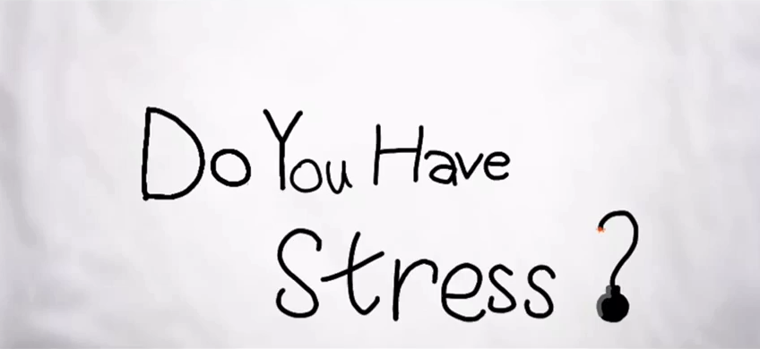
Background Study
- Where does stress come from?

Slide 5
Background Study
- Where does stress come from?
STRESS METER
Go study now!
This is tonight’s homework
No! I’m late for school!
Stop playing games!
Hah Ha You fool! Late again
Students

Slide 6
Background Study
- Why do we even care about stress?
- Where does stress come from?
Physical Impact:
Regular and continuous stress can increase the chance of having heart attacks, seizures, diabetes, stroke and other serious illness.
Mental Impact:
Regular and continuous stress can cause anxiety, depression and other mental illness.
According to South China Morning Post, ¼ pupils reported having considered committing suicide two weeks before the survey, 2% reported they would do so if they had a chance, while 30% of them showed signs of anxiety.

Slide 7
Background Study
- Why do we even care about stress?
According to a research conducted by the Hong Kong Jockey Club Centre for Suicide Research and Prevention, there were 65 suicides in 2015, committed by students (age under 25). It is believed that 70% of the suicides are related to stress issues.
According to a study conducted by the Hong Kong Federation of Youth Groups, out of the 4000 interviewed student, ¼ reported themselves as having a high level of stress and 40% showed signs of anxiety.
According to a study conducted by Baptist Oi Kwan Social Service and the Institute of Education, 51% showed signs of depression, in which, 6.5% were severely depressed.
From the above sources, we can clearly see that stress and stress-related issues are very common among students and can become very serious if not treated correctly.

Slide 8
We did research.
- Research objectives
1. What are the sources of stress?
By knowing this, we can cope with stress and overcome the problems more easily
2. What issues does stress cause?
By knowing this, we can understand what kinds of problems students in Hong Kong are facing as well as know how stress is affecting them
3. What are the most effective ways to cope with stress?
By knowing this, we can suggest and recommend the most effective way to cope with stress to people who are suffering from stress
SO HOW DO WE COPE WITH STRESS?

Slide 9
methodology
- Questionnaire
1. How would you describe your level of stress? ^{No stress at all} 0 → 5 ^{Extremely stressed}
2. In what situations will you most likely come into stress an stress-related issues?
3. What would you usually do to cope with stress?
4. (i) Have you thought of committing suicide due to stress or stress-related issues?
(ii) If yes, did you seek help?
5. Have you constantly experienced any of the following symptoms due to stress?
Bad temper; Overreaction; shortened attention span; Nausea; Lack of appetite; Fatigue; Frustration; Anxiety; Insomnia; Depression

Slide 10
methodology
- Questionnaire
- Analysis
1. How would you describe your level of stress? ^{No stress at all} 0 → 5 ^{Extremely stressed}
Expected result: 3-4 average
Average: 3.211
Senior students (S.5-S.6) average: 3.8
Junior students (S.1-S.4) average: 2.9
We deduced that DSE might be the culprit of the mentioned phenomenon
35.8%
31.7%
17.1%
9.8%
4.1%
1.6%
0
1
2
3
4
5
No stress at all
Extremely stressed

Slide 11
methodology
- Questionnaire
- Analysis
1. How would you describe your level of stress? Average: 3.221
2. In what situations will you most likely come into stress an stress-related issues?
3. What would you usually do to cope with stress?
4. (i) Have you thought of committing suicide due to stress or stress-related issues?
(ii) If yes, did you seek help?
5. Have you constantly experienced any of the following symptoms due to stress?
Bad temper; Overreaction; shortened attention span; Nausea; Lack of appetite; Fatigue; Frustration; Anxiety; Insomnia; Depression

Slide 12
methodology
- Questionnaire
- Analysis
According to our data, interviewed students tend to have more work stress than life stress as shown in the graph.
Parents and teachers tend to push students too hard and give them unrealistic expectations.
In turn, they feel stressed when doing schoolwork. They also fear getting scolded by not performing well in schoolwork which can worsen the symptoms of stress.
Establishing a vicious cycle
2. In what situations will you most likely come into stress an stress-related issues?
Work stress
Life stress
72.4%
40.7%
30.1%
20.3%
14.6%
18.7%
During
class
Doing
schoolwork
Having
tests/
exams
Being
scolded
Hanging
out with
friends
Participating
in social
events

Slide 13
methodology
- Questionnaire
- Analysis
2. In what situations will you most likely come into stress an stress-related issues?
1. How would you describe your level of stress? Average: 3.221
2. In what situations will you most likely come into stress an stress-related issues?
3. What would you usually do to cope with stress?
4. (i) Have you thought of committing suicide due to stress or stress-related issues?
(ii) If yes, did you seek help?
5. Have you constantly experienced any of the following symptoms due to stress?
Bad temper; Overreaction; shortened attention span; Nausea; Lack of appetite; Fatigue; Frustration; Anxiety; Insomnia; Depression
^{Work stress} >_{Life stress}

Slide 14










methodology
- Questionnaire
- Analysis
Expected result: playing video games
Among boys:
1st Listening to music
2nd Sleeping
3rd Playing games
Among girls:
1st Listening to music
2nd Sleeping
3rd Talking to people
--------------------------------- ³¹
------------------------------------------------------ 50
------------------------- ²³
------------------------------------------- 40
------------- ¹²
-------------------------------------- 36
------------------- ¹⁸
------------------------------- 29
----------------------- ²²
----------------------------- 27
-------- ⁸
---------------------------- 26
--------- ⁹
-------------- 13
-------- ⁸
---------- 9
--------- ⁹
------- 7
--- ³
--------- 9
3. What would you usually do to cope with stress?

Slide 15
methodology
- Questionnaire
- Analysis
3. What would you usually do to cope with stress?
1. How would you describe your level of stress? Average: 3.221
2. In what situations will you most likely come into stress an stress-related issues?
3. What would you usually do to cope with stress?
4. (i) Have you thought of committing suicide due to stress or stress-related issues?
(ii) If yes, did you seek help?
5. Have you constantly experienced any of the following symptoms due to stress?
Bad temper; Overreaction; shortened attention span; Nausea; Lack of appetite; Fatigue; Frustration; Anxiety; Insomnia; Depression
^{Work stress} >_{Life stress}

Slide 16





methodology
- Questionnaire
- Analysis
39%
Have thought of
committing suicide
71.1% did not seek help
4. (i) Have you thought of committing suicide due to stress or stress-related issues?
50.4%
Have not thought
of committing suicide
(ii) If yes, did you seek help?
10.6%
Have tried committing suicide

Slide 17
methodology
- Questionnaire
- Analysis
4. (i) Have you thought of committing suicide due to stress or stress-related issues?
1. How would you describe your level of stress? Average: 3.221
2. In what situations will you most likely come into stress an stress-related issues?
3. What would you usually do to cope with stress?
4. (i) Have you thought of committing suicide due to stress or stress-related issues?
(ii) If yes, did you seek help?
5. Have you constantly experienced any of the following symptoms due to stress?
Bad temper; Overreaction; shortened attention span; Nausea; Lack of appetite; Fatigue; Frustration; Anxiety; Insomnia; Depression
^{Work stress} >_{Life stress}
(ii) If yes, did you seek help?
50% Yes
70% No

Slide 18
methodology
- Questionnaire
- Analysis
Among our ~120 interviewed, over 70% of them had reported having 6 or more symptoms.
These symptoms can greatly affect daily lives regarding socials, academics, and also health.
We can see that stress can cause serious effects on our body. We must definitely not ignore this issue and find effective ways to cope with it.
5. Have you constantly experienced any of the following symptoms due to stress?
Bad temper; Overreaction; shortened attention span; Nausea; Lack of appetite; Fatigue; Frustration; Anxiety; Insomnia; Depression

Slide 19
methodology
- Questionnaire
- Conclusion
- Analysis
After analysing, we have conclude that:
Students in Hong Kong suffer from a moderate to high level of stress
Most of the stress comes from exams and tests
Symptoms of stress are very common and are very significant
Stress could drive student to a point where suicide is the only “solution” they see
Vicious cycles are the main way stress can accumulate and build up, as seen in:
Poor academic results
Scolded by parents
Stress builds up
Symptoms appear
Can’t focus

Slide 20
methodology
- Questionnaire
- recommendations
- conclusion
From the data collected, listening to music and sleeping seem to be the most effective way of relieving stress and seem to work for both genders.
But we must not forget that finding out the cause of stress is the most important thing we should do. By finding out the cause, we can pinpoint exactly where the problem starts, where the vicious cycles begin, and stop them before they become a threat.
Share your feelings with others and ask them for help if needed.
No one can live without stress, but only when we learn how to cope with them, we can live a happier life.

Slide 21
Looking back…
- limitations
- Sampling method
Sampling methods are used to conduct experiments or surveys to know the trend of a large population by only knowing the information of a small group. Often in scientific research, systematic sampling or random sampling are used to get the most representative results.
Due to limitations, we can only use convenience sampling.
We used social media (WhatsApp) to distribute our online questionnaire (Google Form). Since we only have one way of distribution, biases are inevitable. For example, most of the respondents might have the same hobby/interest (surfing the internet), more internet-related issues might be chosen as their answers.

Slide 22
Looking back…
- limitations
- Data accuracy
- Sampling method
Due to time limitations, we can’t get too many responses, resulting in a relatively small sample size (~120). This leads to less accurate and less representative results.
Since we can’t keep track of who has responded before, someone may fill in the questionnaire repeatedly or even randomly.
We can use more ways of distribution of the questionnaire. With only one way of distribution, the results are biased towards certain types of people. Moreover, it can increase our sample size, which can help reduce the relative error and render the mentioned issues not so significant.

Slide 23
Division of labour
Data analysis
Design
PowerPoint
Ka
Marwin
Ron
Efren
Adrian
Jeffrey
Background Study
Bill
Methodology

Slide 24
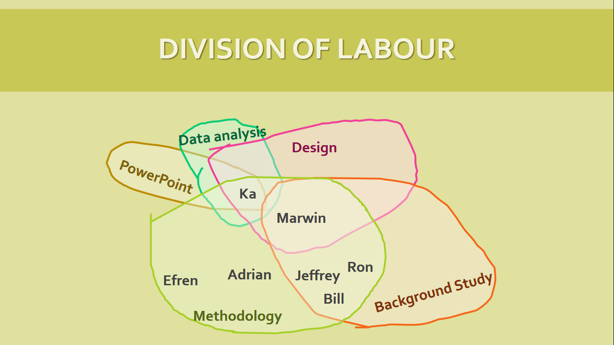








Group reflection
In this project, we have learned how to collect information, how to write a questionnaire and analyse some data. If we could do some improvements, we would start collecting information from questionnaires in order to have a larger sample size, this can make the result more accurate

Slide 25
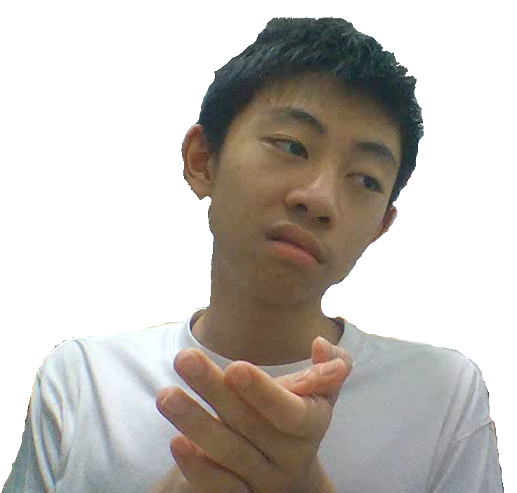

Thanks for listening!

